Slide 1
FLL Lego Offseason

Slide 2
11 sessions
Dates |  | Programming |  | Mechanical
22-Feb | 1 | Intro/Overview |  | Simple Machines
2-Mar | 2 | Driving |  | Simple Machines
8-Mar | 3 | Touch Sensor |  | Simple Machines
30-Mar | 4 | Light Sensor |  | Simple/ Adv Machines
6-Apr | 5 | Gyro |  | Simple/Adv Machines
13-Apr | 6 | Ultra Sonic |  | Advanced Machines
27-Apr | 7 | Spring Fling Prep? |  | or Table Work
4-May | 8 | Spring Fling Prep? |  | or Table Work
11-May | 9 | Spring Fling Prep? |  | or Table Work
 | Spring fling 156 May
18-May | 10 | Table Work |  | Advanced Machines
1-Jun | 11 | Table Work |  | Advanced Machines

Slide 3
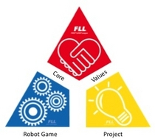
1
Intro
  Ground rules
  5 minutes Core Values
  Show table
  Overview of Parts of FLL
    Core Values
    Project
    Robot Design
    Table Competition
  Pass out Old Table competition description
  Dijkastra’s Law(s)
  Simple Machines/ Programming Overview
Software and mechanical design focus

Slide 4
Ground Rules
  Ground rules
  We have what we have
    Don’t break it on purpose or we won’t have that
    Follow the core values
      Or just be nice
  No competition bearing down on us
    No time pressure
    Don’t work frustrated
    Don’t get frustrated at team members
      Now is our chance to make everyone strong

Slide 5
Core Values
Mostly line up with MVS Core Values – with a team focus
▲ We are a team.
▲ We do the work to find solutions with guidance from our Coaches and Mentors.
▲ We know our Coaches and Mentors don’t have all the answers; we learn together.
▲ We honor the spirit of friendly competition.
▲ What we discover is more important than what we win.
▲ We share our experiences with others.
▲ We display Gracious Professionalism® and Coopertition® in everything we do.
▲ We have fun.

Slide 6
Team Challenge Anyone?

Slide 7

Project
Identify a Real-World Problem
  They’ll pick the theme
Create an Innovative Solution
  We probably need a field trip or 2 to visit experts
3. Share Your Research and Solution
About the level of a 3rd grade Mrs. Paul project
Cave Johnson-
They say great science is built on the shoulders of giants. Not here. At Aperture, we do all our science from scratch. No hand holding."

Slide 8
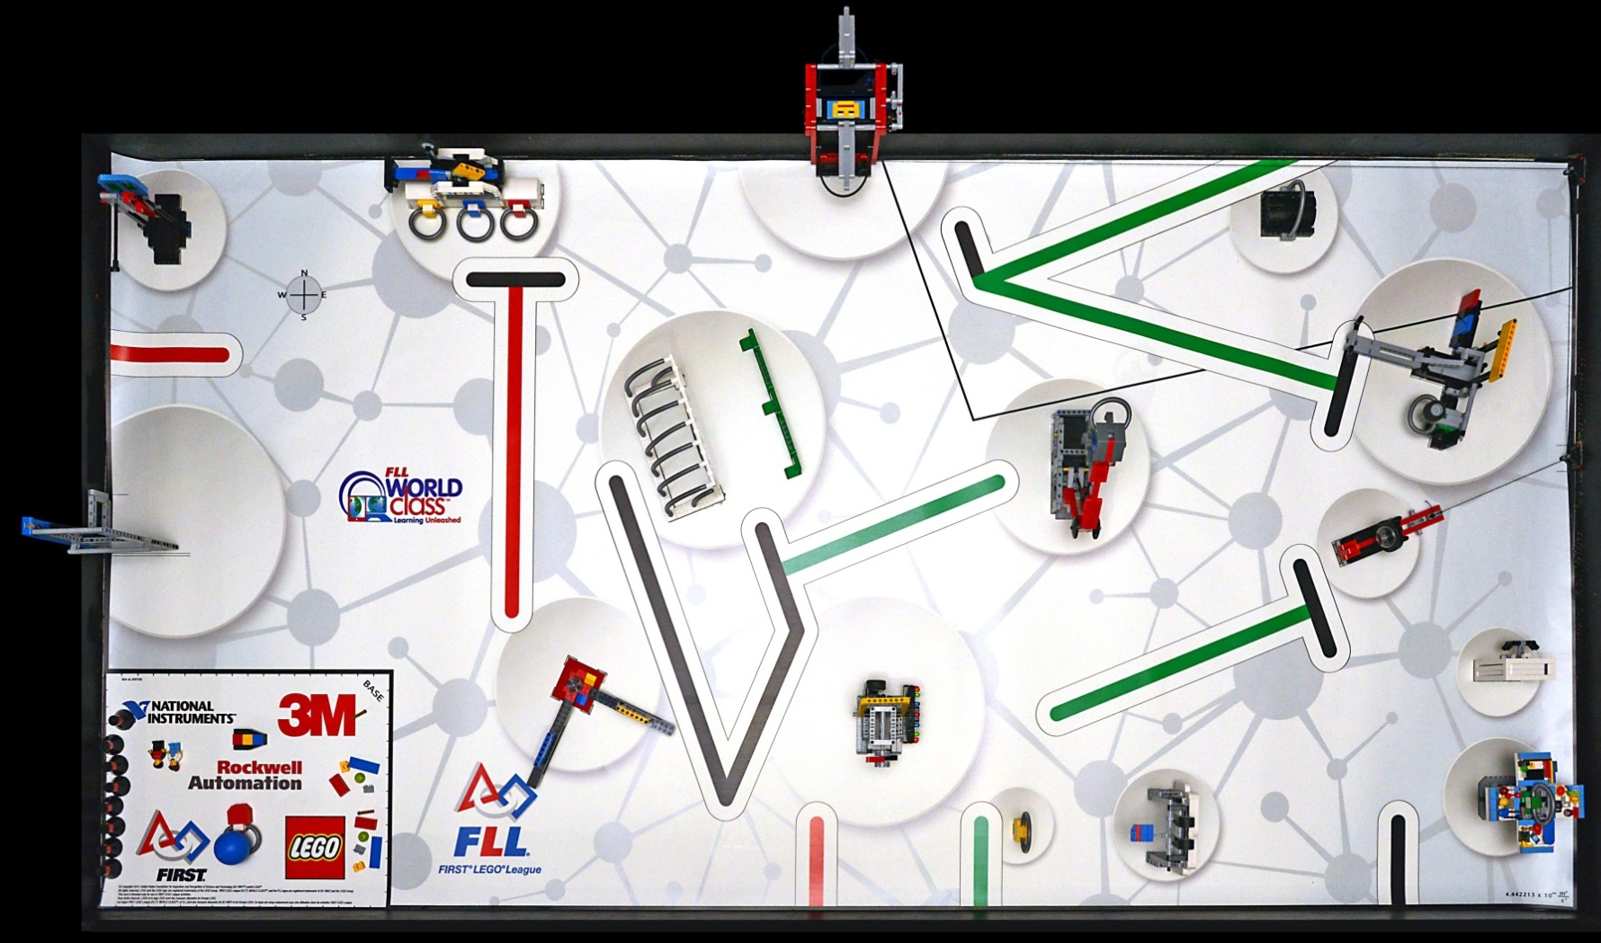
Table Talk

Slide 9
Lets build
I know this is easy for you – but we have to start somewhere
  Think about what each part really does

Slide 10
2
  5 minutes Core Values
  I forgot Dijkastra’s Laws Last week
Amdahl’s Law
Discussion of Table Potential Plans
Build Robots / Driving Programming

Slide 11
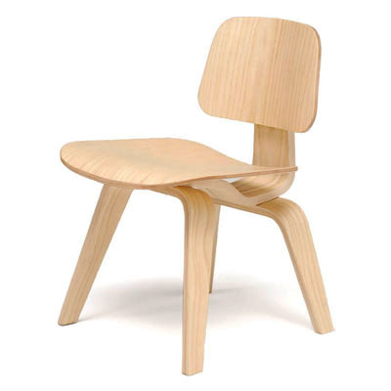
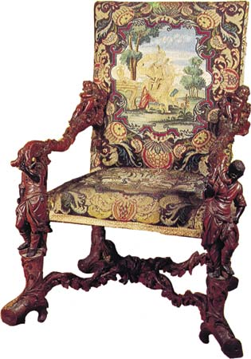
Dijkastra’s
Introduced the concept of simplicity to software (before your mom met your dad)
Introduced the term “not helpful”

Slide 12
Building Robots
I hope we build 10 different robots before we have to build “our own”
Notice how construction is accomplished
  Single Connections/Quadruple Connections
  We’ll keep 1 or 2 together for programming

Slide 13
3
  Teamwork Challenge (30 minutes) pipes/marble
  5 minutes Core Values
Eisenhower's Planning Maxim
Discussion of Table Potential Plans
Simple Machines/Driving

Slide 14
Core Values
Mostly line up with MVS Core Values – with a team focus
▲ We are a team.
▲ We do the work to find solutions with guidance from our Coaches and Mentors.
▲ We know our Coaches and Mentors don’t have all the answers; we learn together.
▲ We honor the spirit of friendly competition.
▲ What we discover is more important than what we win.
▲ We share our experiences with others.
▲ We display Gracious Professionalism® and Coopertition® in everything we do.
▲ We have fun.

Slide 15
4
  Teamwork Challenge (15 minutes) blanket
  5 minutes Core Values
  Brooks Law
  Brainstorm for Spring Fling Tasks?
  Discussion of Table Potential Plans
Simple Machines/Adv Machines
Light sensor programming

Slide 16
5
  Teamwork challenge (15 minutes) blind build
  5 minutes Core Values
  Brainstorm for Spring Fling Tasks
Gyro programming
Simple/Advanced Machines
Pareto Principle

Slide 17
6
  Running a meeting
  5 minutes Core Values
  Ultra Sonic Sensor
  Advanced Machines
  Hofstadter’s Law/Murphy’s Law

Slide 18
7
  Running a meeting
  5 minutes Core Values
Spring Fling Prep
Linus’s Law

Slide 19
8
  5 minutes Core Values
Spring Fling Prep - 2 more meetings before Spring fling
Boehm’s second law
  Prototyping (significantly) reduces requirement and design errors, especially for user interfaces

Slide 20
Core Values
Mostly line up with MVS Core Values – with a team focus
▲ We are a team.
▲ We do the work to find solutions with guidance from our Coaches and Mentors.
▲ We know our Coaches and Mentors don’t have all the answers; we learn together.
▲ We honor the spirit of friendly competition.
▲ What we discover is more important than what we win.
▲ We share our experiences with others.
▲ We display Gracious Professionalism® and Coopertition® in everything we do.
▲ We have fun.

Slide 21
Todo List
Pick up 3rd tire
  Where should we put tires ?
Tweaks to existing system
  Speed
  Reliability
  Flexibility
Tire holding Jig System
Finish 2nd Arm (maybe make a 3rd Arm)
Should probably drive a little so we don’t fall behind

Slide 22
9
  Running a meeting
  5 minutes Core Values
  Spring Fling Prep

Slide 23
End of Season
Watch some solutions
Next Years sales pitch
Pick a name
Experiments
  Matched Wheels
  Matched MOtors
  Wheel size on speed/turning
  Wheel count
  2+ drag or 2 + slip
Positions for next year

Slide 24
CRMS (175)
..\Downloads\FLL World Class 2014- 175 points- Team 6749.mp4

Slide 25
Takota (205)*
..\Downloads\FLL World Class Pre-Qual 205 Points.mp4

Slide 26
R Cubed- 205
..\Downloads\First loop completed!!!205 points for FLL World Class 2014.mp4

Slide 27
Edugators (315)
..\Downloads\Edugators FLL 2014 Regionals Tournament - 315 Points.mp4

Slide 28
Robokunnid (778)
..\Downloads\FLL world class - 778 points - Robokunnid.mp4

Slide 29
Next Year
..\Downloads\2015-2016 TRASH TREK Trailer.mp4

Slide 30
Core Values
Mostly line up with MVS Core Values – with a team focus
▲ We are a team.
▲ We do the work to find solutions with guidance from our Coaches and Mentors.
▲ We know our Coaches and Mentors don’t have all the answers; we learn together.
▲ We honor the spirit of friendly competition.
▲ What we discover is more important than what we win.
▲ We share our experiences with others.
▲ We display Gracious Professionalism® and Coopertition® in everything we do.
▲ We have fun.

Slide 31
Names
Charlie is my Favorite Brother
Acronyms
  CCBB
    Charlie (Comma) the Best Brother
  C2B2
Conjunction
  FLL + Charlie = Flarlie
  Charlie + spectacular = Chartacular
  Charlie + Fantastic = Chartastic
Song Lyrics
  “Let it Charlie!” “Everything is Charlie”

Slide 32
10
  Positions for next year:
    Researching – gather information about the Challenge theme, related real-world problems, and existing solutions. Invite professionals to share their knowledge with the team.
    Community Sharing – consider who in the community might be impacted by or interested in your team’s problem and arrange to share your findings with them.
    Presenting – design a creative presentation to show the judges your team’s work on the Project.
    Strategy Analysis – analyze the robot playing field and formulate various methods for accomplishing the missions. Lead the effort to establish a consensus on the final strategic plan and think about risks and rewards of different strategies.
    Building – make decisions about building and work to form consensus on the mechanical design of the robot among team members.
    Programming – make decisions about programming and form consensus on programming for the robot.
    Project Management – get everyone focused, make sure everyone’s ideas are heard, find compromises, and keep everyone on schedule with a timeline.
    Marketing – design and create a team logo, T-shirt, or banner. Write a press release and contact the local media to increase public awareness of the team and how the team benefits from the FLL experience.

Slide 33
Goals

Slide 34
schedule
May – September
  Online registration
Early September
  Challenge Announcement
Early September – November
  Build and research
November – January
  Tournament Season

